Slide 1
Welcome to the TUM School of Management Webinar Course Planning and Scheduling for Bachelor Students + Q&A Session
We will start at 10:00 am.
Before we begin, please read the following information.
First, the info session will be divided into two parts: An introduction and a presentation part about TUMonline’s functions regarding course planning and scheduling and secondly, a Q&A session. Please save your questions for the Q&A session.
Second, here is the chatiquette for the Q&A session:
Please only use the Q&A Pod for asking questions. For the sake of clarity, questions will only be shown once they have been answered by us. Questions in the chat window will not be answered.
All messages in English, please!
Please give us enough time to answer your questions. This means: 1) Please wait with your message if you see that other participants have already written several questions. 2) Please do not keep messaging and messaging.
We intend to answer EVERY question. If you feel that your question has been lost among the others, please feel free to repost it after a while.
Give others a chance to ask as well.
Don't worry about correcting typos. We all know they happen.
Hopefully there will never be a reason to get angry in this chat. In any case, please remain calm and polite.
By participating, you agree that we may share the transcript of the chat session with other prospective students interested in our programs. Please keep this in mind when posting.

Slide 2
Course Planning and Scheduling for Bachelor Students – Webinar + Q&A Session
TUM School of Management
Winter Semester 2023/24

Slide 3
Important
This session will be recorded.
The slides of the presentation and the protocol / transcript of the Q&A session will be uploaded to the bachelor moodle course for freshers and can be made available to all other students upon request by emailing to the student counseling team.

Slide 4
Your hosts and speakers today
Special guest:
Edo Octavianus (Live Demo & Q&A)
Curriculum Planning/Course Scheduling Specialist
Student Counseling Team:
Michaela Krieger (Introduction & Q&A)
Program Manager Bachelor Management & Technology
Andreas Bauerfeld (Q&A)
Program Manager Master Management & Technology

Slide 5
Agenda
Welcome and introduction
Live presentation by Edo Octavianus: Tips and tricks regarding course planning and scheduling at TUM School of Management
Q&A session (chat via Q&A pod)
1
2
3
Objective: Get the most out of TUMonline and create your personal semester schedule.

Slide 6
Planning is especially important for:
Students coming from other universities who may have academic credits and require individualized course planning and scheduling.
Flexible parts in your schedule in higher semesters:
Electives in your specialization in technology
Electives in management or technology („WTW“)
Free/additional courses (not considered for your program)
Freshers who start their first degree program, please refer to the course schedules at https://www.mgt.tum.de/programs/bachelor-management-technology/munich/for-current-students
(please do not use the semester plans in TUMonline which may contain errors!)

Slide 7
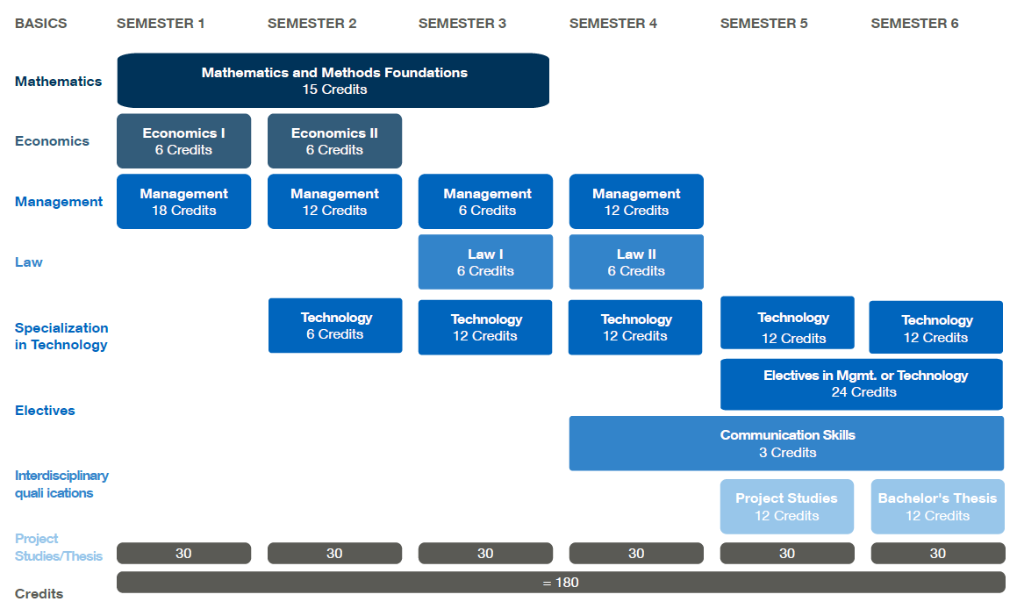
General rule
Required modules first! To the right is an ideal study plan. This is a suggestion.
A general introduction to TUMonline can be found here: https://wiki.tum.de/display/docs/Studierende

Slide 8
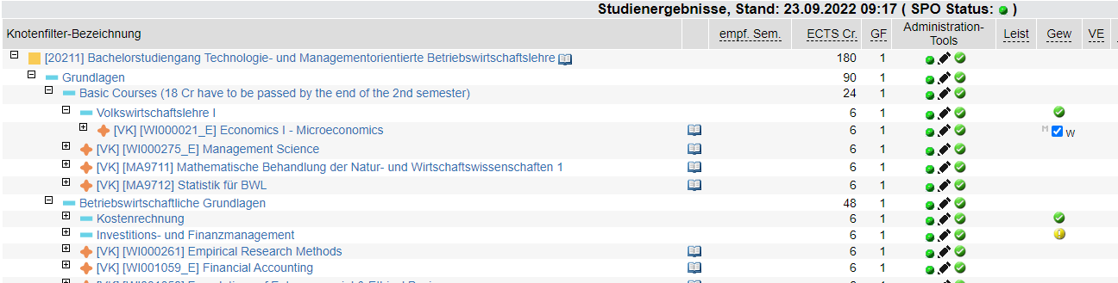
Planning your schedule
As a general rule:
Please do not check any boxes, when selecting courses
You cannot change the selection yourself!
!

Slide 9
Credit transfer (recognitions)
The relevant chair decides which courses can be recognized.
We cannot influence this process, and it may take some time.
Are you sure that your credits will be recognized?
Skip this module and register only if your request for recognition is rejected.
Not sure whether your credits will be recognized?
Please register and attend the course.
For recognition of courses of TUMcourses, please send an email to the Grade Management Office (grademanagement@mgt.tum.de)

Slide 10
Program-specific or individual questions?
Check the content we provide for your program on our website (e.g. course schedules):
https://www.mgt.tum.de/programs/bachelor-management-technology/munich/for-current-students
Check the program-specific academic and examination regulations (FPSO), available in the Download Center

Slide 11
Thank you for your attention! Edo, it‘s your turn ☺

Slide 12
Program-specific or individual questions?
Check your curricular support/study plan in your TUMonline account.
Still individual questions?
For (technical) questions regarding courses (without limited places), please contact: lv-management@mgt.tum.de
For administrative or technical questions regarding exams, please contact: examregistration@mgt.tum.de
For individual questions regarding your study plan, please contact your program manager via studentcounseling_bachelor@mgt.tum.de

